Slide 1
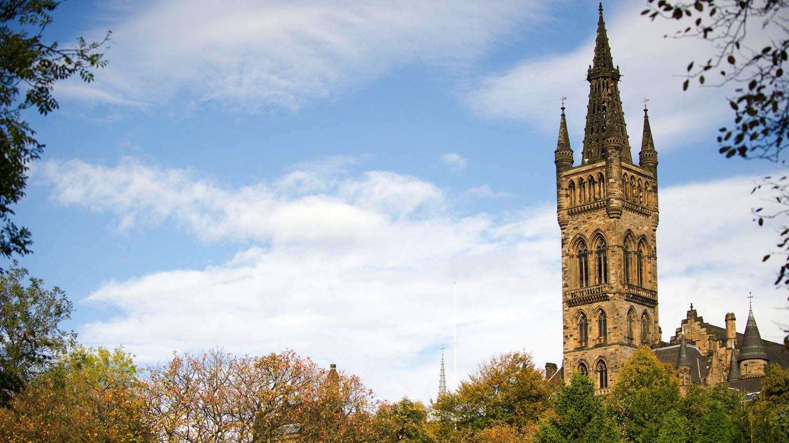


MSC Team Project Large-Scale Learning: Query-driven Machine Learning over Distributed Data Supervisor: Dr. Christos Anagnostopoulos & Dr. Nikos Ntarmos
Kurt Portelli, Natascha Harth, Ruben Giaquinta,
Xu Zhang, Monica Gandhi

Slide 2
Problem Definition

Slide 3
Problem
Predicting the results of queries by clustering underlying distributed data without having access to it.
Large Data sets - very costly to query
traditional methods (such as histograms, sketches..) require dataset
Restricted / no access to data Set
Create a system that can predict the results of queries
without having access to the dataset
Fast querying
Not running actual query (prediction)

Slide 4
Query driven approach

Slide 5
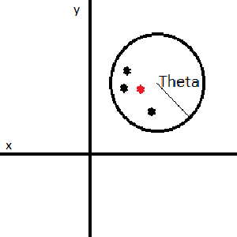
Query driven approach
Generate Random Query over subspaces
Run query to get Average result
Repeat this to generate a training set
query | avg point
query | avg point
query | avg point
Training Set -> Learning -> Prediction

Slide 6
Clustering

Slide 7
Clustering Methods
Nearest Neighbour
Batch K-means
Online K-means
ART

Slide 8
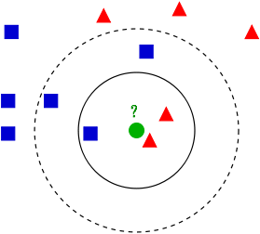
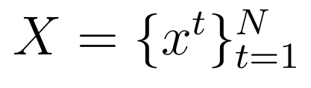
Nearest Neighbors
Sample
Pseudocode
initialize k;
for each x ∈ X:
∀ x’ ∈ X, calculate the euclidean distance between x and x’.
classify x as the majority class between the k nearest neighbors.

Slide 9
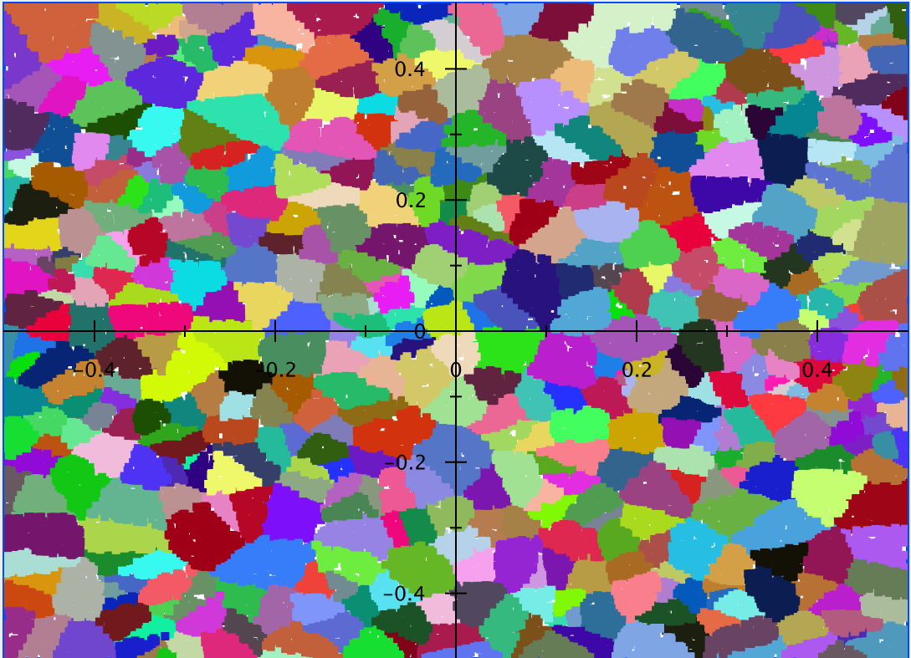
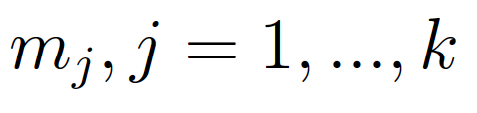
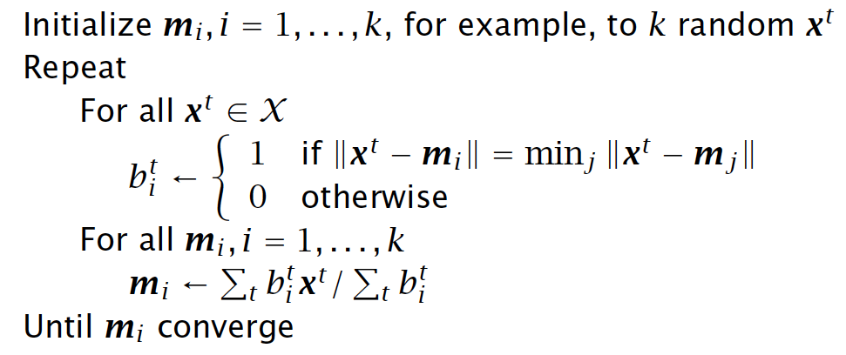
Batch K-means
Sample
Reference vectors
Pseudocode

Slide 10
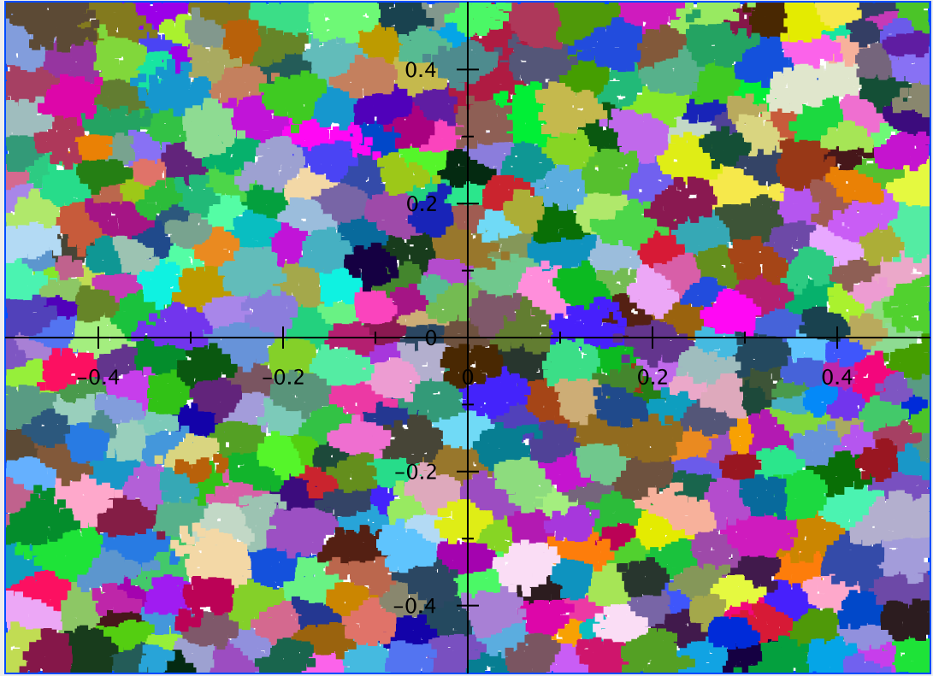
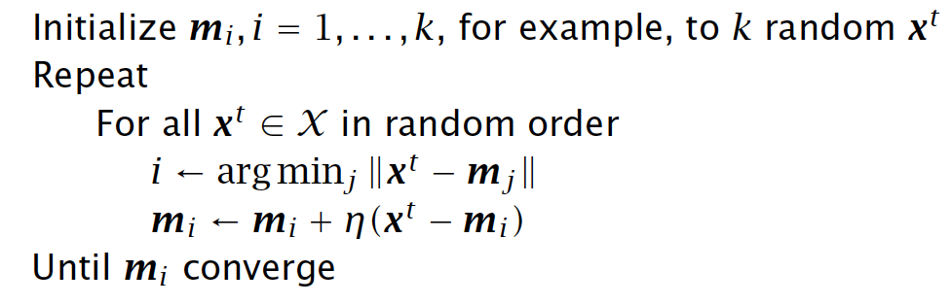
Online K-means
Sample
Reference vectors
Pseudocode

Slide 11
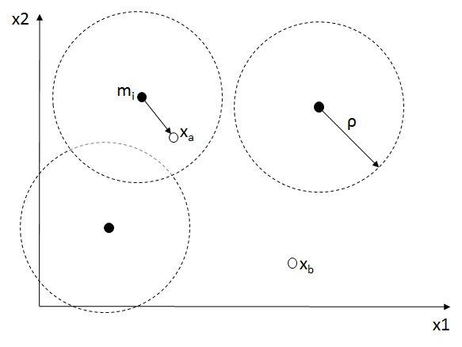
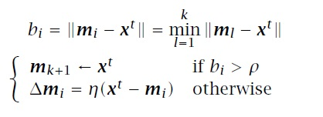
ART
Adaptive Resonance Theory is a neural network model for unsupervised learning.
Consider dataset
The following equations are performed
for each update

Slide 12

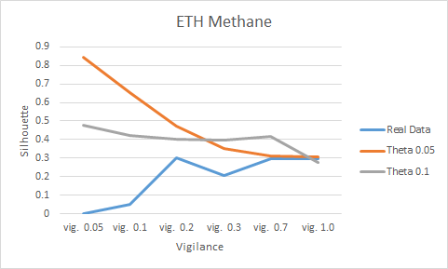
Silhouette
Silhouette is an evaluation method to verify the quality of a cluster.
a(i) - average distance from the i^{th} point to the other points in the same cluster as i
b(i) - the minimum average distance from the i^{th} point to points in a different cluster
s(i) ranges from -1 to 1
•Values close to 1 –> point is in the right cluster
•Values close to -1 –> point is in the wrong cluster
•Values close to 0 –> point is in the border of two clusters

Slide 13
Query Space Clustering

Slide 14
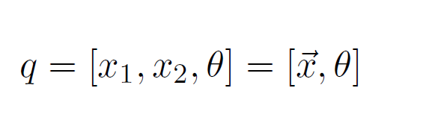
Query Space Clustering
Only partition the queries, i.e., the vectors with centre X and radius THETA
For example, consider that the input of the query Q
NOT generate x₁ and x₂ value uniformly at random in the whole space
(two dimensions)

Slide 15
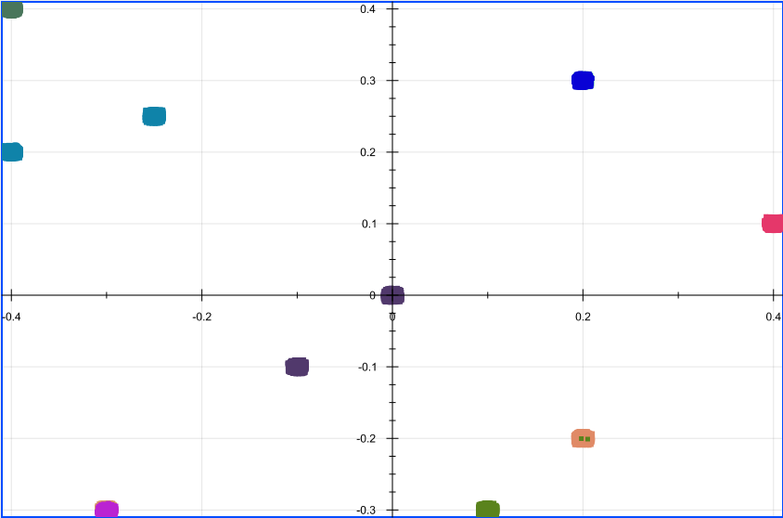
Pre-define Subspaces
What is Subspaces?
The idea is to simulate the areas of interest of users, i.e., users normally issues from these subspaces.
Assume that there is a fix data subspace called J which contains L=10 subspaces, J = 1, 2, … , L.
The subspace set J is modelled through a Gaussian distribution of 2 dimensions.
fix data subspace J (L=10)

Slide 16
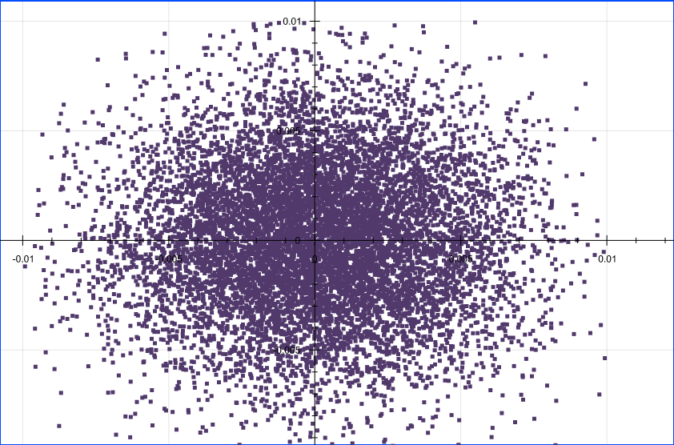
Gaussian Distribution
The subspace set J is modelled through a Gaussian distribution of 2 dimensions.
Zoom in to a certain subspace in J

Slide 17
Query Space Clustering
For q = 1, 2, … , 100000
// select a subspace
J = Random.Integer(1, L)
// generate a query from the J-th subspace
X1 = Random.Gaussian (M1[J], V1)
X2 = Random.Gaussian (M2[J], V2)
THETA = 0.01
Q = [X1, X2, THETA]
// inject the query Q in the incremental K-means algorithm
Insert(Q, Online K-means)
End For

Slide 18
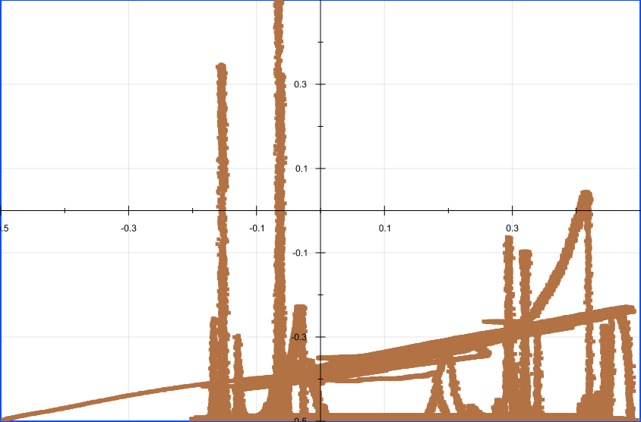
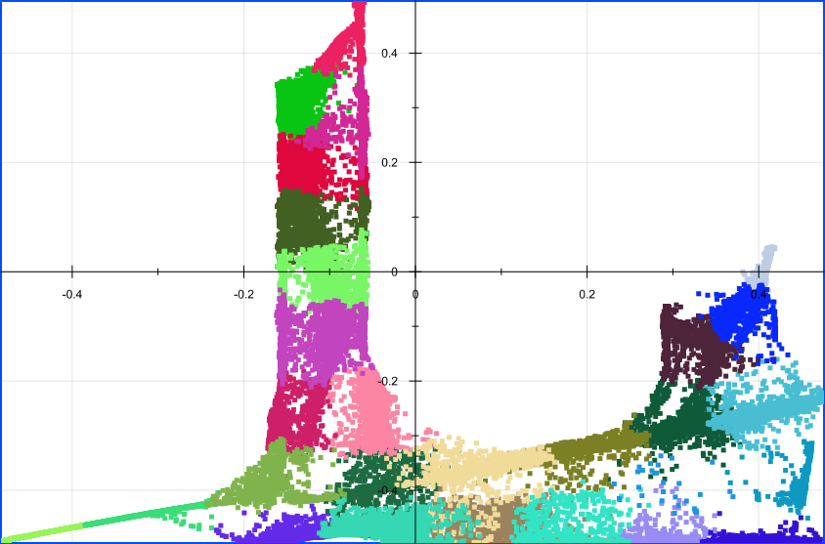
Example
Real Data
AVG Data

Slide 19
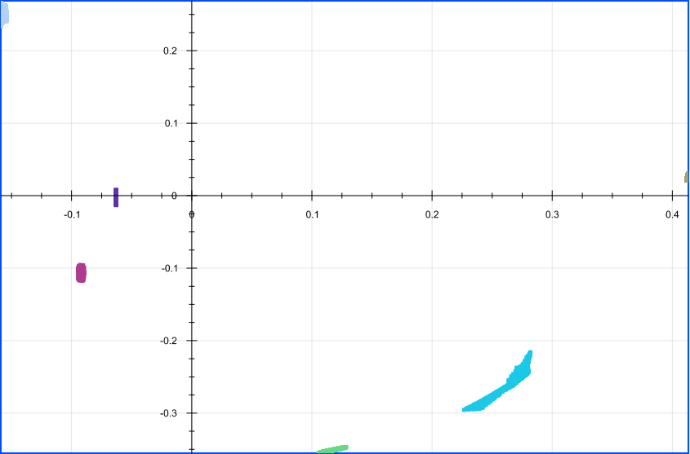
Evaluation
Positions between J and query clustering
Distance between two queries
Remind J :
Query Space
Query Output

Slide 20
Prediction

Slide 21
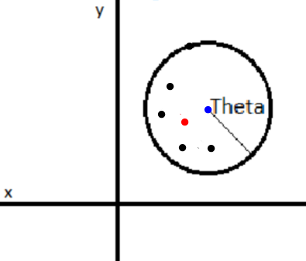
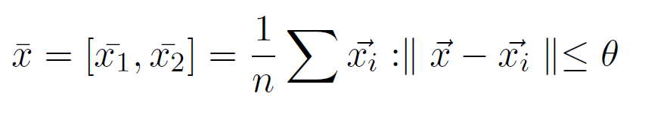
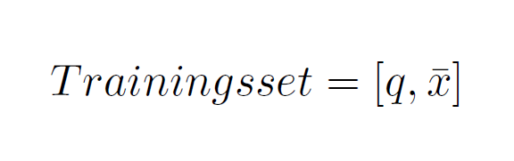
Mapping
query | avg point
query | avg point
query | avg point

Slide 22
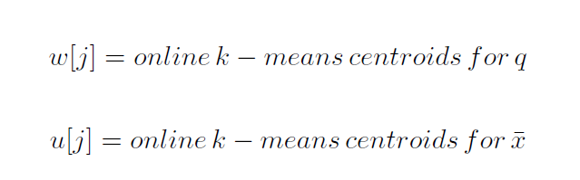
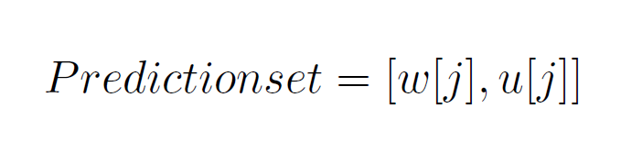
Learning

Slide 23
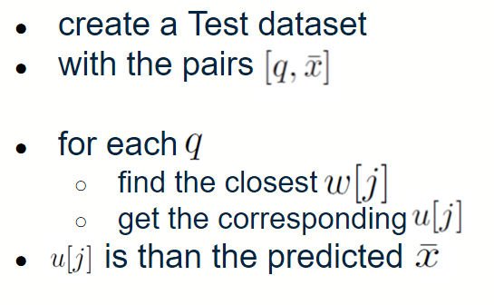
Prediction

Slide 24
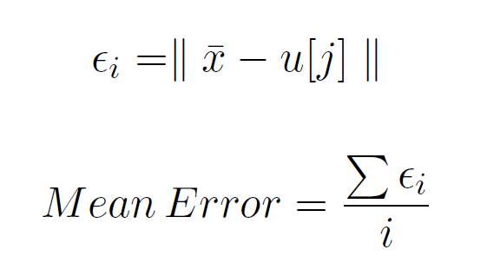
Error/Evaluation

Slide 25
Demo

Slide 26
Conclusion

Slide 27
Conclusion
We have a system that:
Abstracts query similarity to cluster distributed data
Associates queries with aggregation results (prediction)
Works even when access to data is restricted/limited

